Slide 1
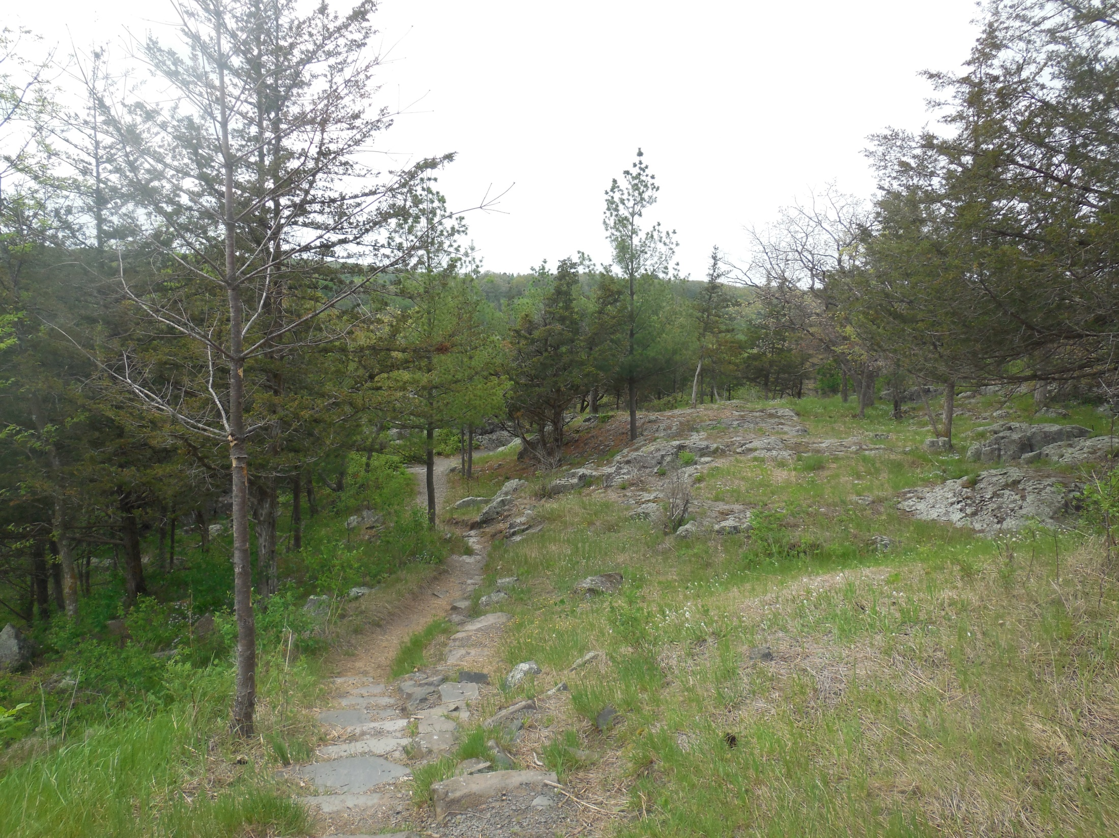
Outdoorsman’s
Waypoint Plotter
Maximum interaction with your environment. Minimum interaction with your phone

